Slide 1



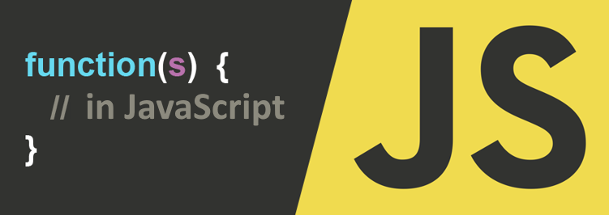
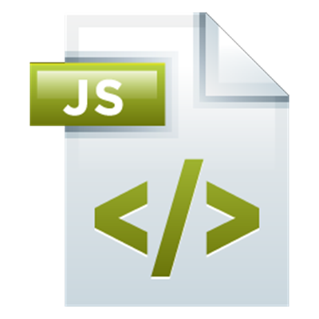
Functions and Arrow Functions
Functions, Parameters, Return Value, Arrow Functions (Lambda)
Functions in JavaScript
SoftUni Team
Technical Trainers
Software University
http://softuni.bg

Slide 2



Table of Contents
Functions: Declare, Invoke, Using Parameters
Return Value
Function Variables
Arrow Functions (Lambda)
Nested Functions

Slide 3
Have a Question?
sli.do #5595

Slide 4
JavaScript Functions Overview
Declaring and Invoking Functions

Slide 5
Functions in JS
Function == named piece of code
Can take parameters and return result
Function name: use camelCase
Function parameters: use camelCase
function printStars(count) {
console.log("*".repeat(count));
}
The { stays at the same line
Invoke the function
printStars(10);

Slide 6
Problem: Triangle of Stars
Write a JS function to print a triangle of stars of size n
1
*
*
** *** ****
***
**
*
*
** ***
**
*
3
4
*
**
*
2

Slide 7
Solution: Triangle of Stars
Functions in JS can be nested (function inside a function)
*
** ***
**
*
function printTriangle(n) {
function printStars(count) {
console.log("*".repeat(count));
}
for (let i=1; i<=n; i++) printStars(i);
for (let i=n-1; i>0; i--) printStars(i);
}
printTriangle(3);
Check your solution here: https://judge.softuni.bg/Contests/306

Slide 8
Default Function Parameter Values
Functions in JS can have default parameter values
function printStars(count = 5) {
console.log("*".repeat(count));
}
printStars(); // *****
printStars(2); // **
printStars(3, 5, 8); // ***

Slide 9
Problem: Square of Stars
Write a JS function to print a square of stars
function squareOfStars(n) {
function printStars(count = n) {
console.log("*" +
" *".repeat(count-1));
}
for (let i=1; i<=n; i++)
printStars();
}
* * *
* * *
* * *
3
* * * *
* * * *
* * * *
* * * *
4
Check your solution here: https://judge.softuni.bg/Contests/306

Slide 10
Function Overloading
In C# / Java / C++ functions can be overloaded
Function overloading == same name, different parameters
JavaScript (like Python and PHP) does not support overloading
function printName(firstName, lastName) {
let name = firstName;
if (lastName != undefined)
name += ' ' + lastName;
console.log(name);
}
Simulate overloading by parameter checks
printName('Maria');
printName('Maria','Nikolova');

Slide 11
Variable Number of Arguments
JS functions have special array arguments
function sum() {
console.log("args count: " + arguments.length);
console.log(arguments);
let sum = 0;
for (let x of arguments)
sum += x;
console.log("sum = " + sum);
}
sum(); // 0 [] 0
sum(5, 3); // 2 [5, 3] 8
sum(4, 2, 3); // 3 [4, 2, 3] 9

Slide 12
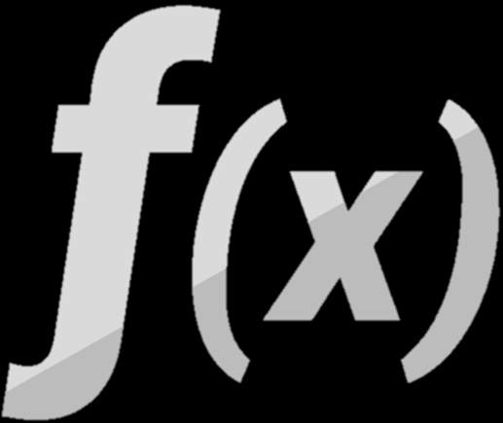


Returning Values from a Function

Slide 13
Functions Can Return Values
function multiply(a, b) {
return a * b;
}
let m = multiply(3, 5);
console.log(m); // 8
function hello() {
console.log("hello");
}
let v = hello();
console.log(v); // undefined

Slide 14
Returning Values – Examples
function check(a) {
if (a > 0)
return "positive";
if (a < 0)
return "negative";
}
The function sometimes return a string, sometimes returns undefined
console.log(check(5)); // positive
console.log(check(-5)); // negative
console.log(check(0)); // undefined
console.log(check()); // undefined
console.log(check("hello")); // undefined

Slide 15
Problem: Symmetry Check (Palindrome)
Write a JS function to check a string for symmetry
Examples: "abcccba" → true; "xyz" → false
function isPalindrome([str]) {
for (let i=0; i<str.length/2; i++)
if (str[i] != str[str.length-i-1])
return false;
return true;
}
isPalindrome(["abba"]); // true
Check your solution here: https://judge.softuni.bg/Contests/306

Slide 16
Problem: Day of Week
Write a JS function to return the day number by day of week
Example: "Monday" → 1, …, "Sunday" → 7, other → "error"
JS functions can return mixed data type: e.g. number or string
function dayOfWeek(day) {
if (day == 'Monday') return 1;
…
if (day == 'Sunday') return 7;
return "error";
}
dayOfWeek("Monday"); // 1
Check your solution here: https://judge.softuni.bg/Contests/306

Slide 17


Function Variables
f =
Variables Holding Functions

Slide 18
Variables Holding Functions
In JS variables can hold functions as their values
let f = function(x) { return x * x; }
console.log(f(3)); // 9
console.log(f(5)); // 25
f = function(x) { return 2 * x; }
console.log(f(3)); // 6
console.log(f(5)); // 10
f = undefined;
console.log(f(3)); // TypeError: f is not a function(…)

Slide 19
Functions as Parameters
function repeatIt(count, func) {
for (let i = 1; i <= count; i++)
func(i);
}
let starsFunc = function(i) {
console.log("**".repeat(i))
};
repeatIt(3, starsFunc);
repeatIt(3, function(x) { console.log(2 * x); } );
**
****
******
2
4
6

Slide 20
Problem: Functional Calculator
Write a calculator that takes two numbers and an operator and performs a calculation between them using the operator
function calculate([a, b, op]) {
[a, b] = [a, b].map(Number);
let calc = function(a, b, op) { return op(a, b) };
let add = function(a, b) { return a + b };
let subtract = function(a, b) { return a - b };
let multiply = function(a, b) { return a * b };
let divide = function(a, b) { return a / b };

Slide 21
Problem: Functional Calculator (2)
switch (op) {
case '+': return calc(a, b, add);
case '-': return calc(a, b, subtract);
case '*': return calc(a, b, multiply);
case '/': return calc(a, b, divide);
}
}
console.log(calculate(['2', '4', '+'])) // 6
console.log(calculate(['9', '2', '/'])) // 4.5
Check your solution here: https://judge.softuni.bg/Contests/306

Slide 22
IIFE
Immediately-invoked function expression (IIFE)
(function (count) {
for (let i = 1; i <= count; i++)
console.log('+'.repeat(i));
})(4);
+
++
+++
++++
This is called "closure" (a state is closed inside)
let f = (function () {
let x = 0;
return function() { console.log(++x); }
})(); f(); f(); f(); f();
1
2
3
4

Slide 23
Arrow Functions is JS (Lambda)
() => …
() => …
Short Syntax for Anonymous Functions

Slide 24
Arrow Functions
Functions in JS can be written in short form using "=>" (arrow)
let increment = x => x + 1;
console.log(increment(5)); // 6
let increment = function(x) {
return x + 1;
}
This is the same as the above function
let sum = (a, b) => a + b;
console.log(sum(5, 6)); // 11

Slide 25
Problem: Aggregate Elements
Write a function to aggregate elements
The elements are given as array, e.g. [1, 2, 3]
Start by given initial value, e.g. 0
At each iteration apply given aggregate function e.g. a + b
aggregate([10, 20, 30], 0, (a, b) => a + b); // 60
aggregate([10, 20, 30], 1, (a, b) => a * b); // 6000
Input elements
Initial value
Aggregate function

Slide 26
Problem: Sum / Inverse Sum / Concatenate
Using the aggregating function, calculate:
Sum of elements
e.g. [1, 2, 4] → 1 + 2 + 4 → 7
Sum of inverse elements (1/a_{i})
E.g. [1, 2, 4] → 1/1 + 1/2 +1/4 → 7/4 → 3.5
Concatenation of elements
e.g. ['1', '2', '4'] → '1'+'2'+'4' → '124'

Slide 27
Solution: Aggregate Elements
function aggregateElements(input) {
let elements = input.map(Number);
aggregate(elements, 0, (a, b) => a + b);
aggregate(elements, 0, (a, b) => a + 1 / b);
aggregate(elements, '', (a, b) => a + b);
function aggregate(arr, initVal, func) {
let val = initVal;
for (let i = 0; i < arr.length; i++)
val = func(val, arr[i]);
console.log(val);
}
}
aggregateElements([10, 20, 30]); // 60 1.833 102030
Check your solution here: https://judge.softuni.bg/Contests/306

Slide 28

Nested Functions

Slide 29
Problem: Words Uppercase
Functions in JS can be nested, i.e. hold other functions
Inner functions have access to variables from their parent
function wordsUppercase([str]) {
let strUpper = str.toUpperCase();
let words = extractWords();
words = words.filter(w => w != '');
return words.join(', ');
function extractWords() { return strUpper.split(/\W+/); }
}
wordsUppercase(['Hi, how are you?']); // "HI, HOW, ARE, YOU"
extractWords(['Hello functions']); // ReferenceError
Check your solution here: https://judge.softuni.bg/Contests/306

Slide 30

Practice: Functions in JS
Live Exercises in Class (Lab)

Slide 31

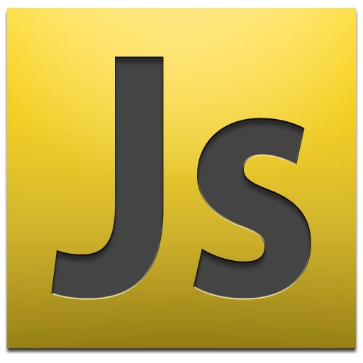
Summary
Function == named piece of code
Can take parameters and return result
Arrow functions ≈ short function syntax
function calcSum(a, b) {
let sum = a + b;
return sum;
}
[10, 20, 30].filter(a => a > 15);

Slide 32










Functions and Arrow Functions
https://softuni.bg/courses/javascript-fundamentals

Slide 33
License
This course (slides, examples, demos, videos, homework, etc.) is licensed under the "Creative Commons Attribution-NonCommercial-ShareAlike 4.0 International" license

Slide 34






Free Trainings @ Software University
Software University Foundation – softuni.org
Software University – High-Quality Education, Profession and Job for Software Developers
softuni.bg
Software University @ Facebook
facebook.com/SoftwareUniversity
Software University @ YouTube
youtube.com/SoftwareUniversity
Software University Forums – forum.softuni.bg

